Slide 1
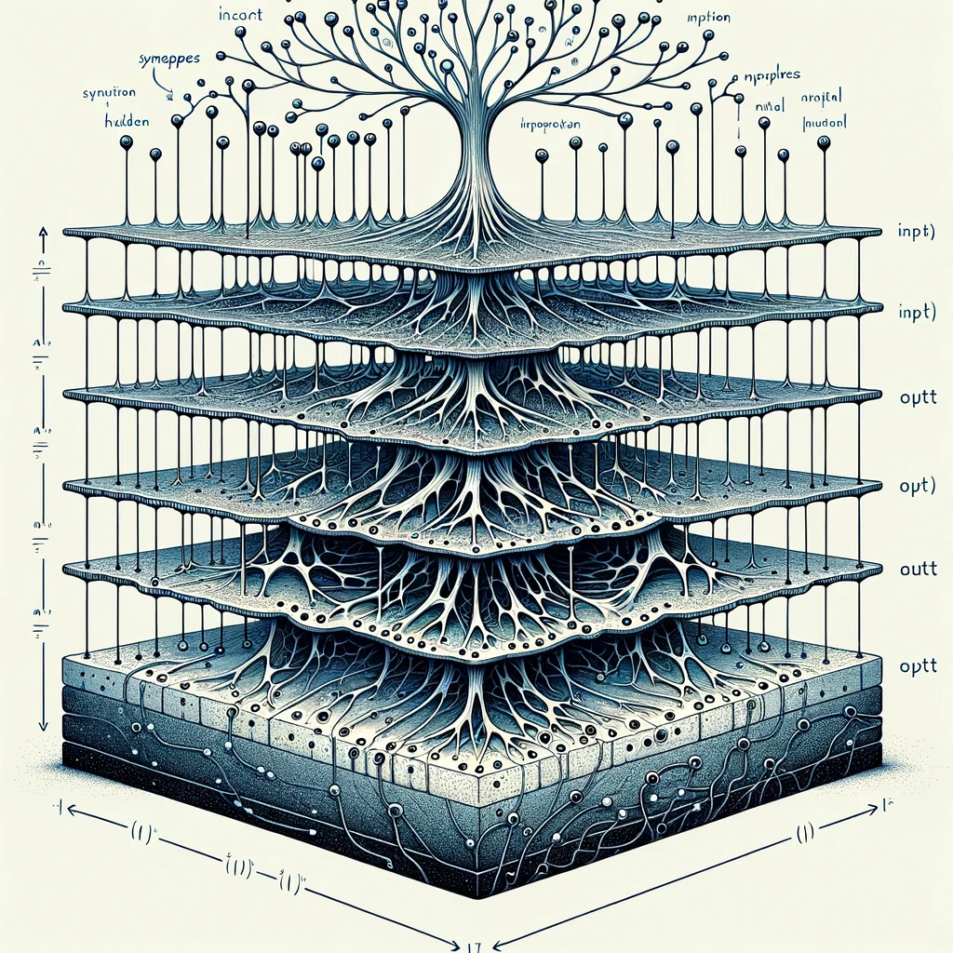
kokchun giang
multilayered perceptron (MLP) for image classification

Slide 2


strategy for building a an MLP

Slide 3















image classification with MLP

Slide 4
questions to consider

Slide 5





questions to consider

Slide 6



decrease overfitting

